Slide 1
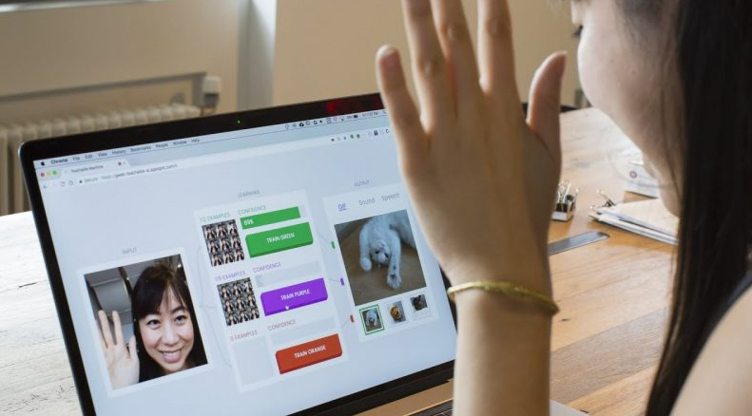
Artificial Intelligence Classification of Image / Sound / Pose using Teachable Machine https://teachablemachine.withgoogle.com/

Slide 2
What is Teachable Machine?
Teachable Machine is a web-based tool that makes creating machine learning models fast, easy, and accessible to everyone.
Train a computer to recognize your own images, sounds, & poses. A fast, easy way to create machine learning models for your sites, apps, and more – no expertise or coding required.
An AI experiment made from Google since 2017.

Slide 3
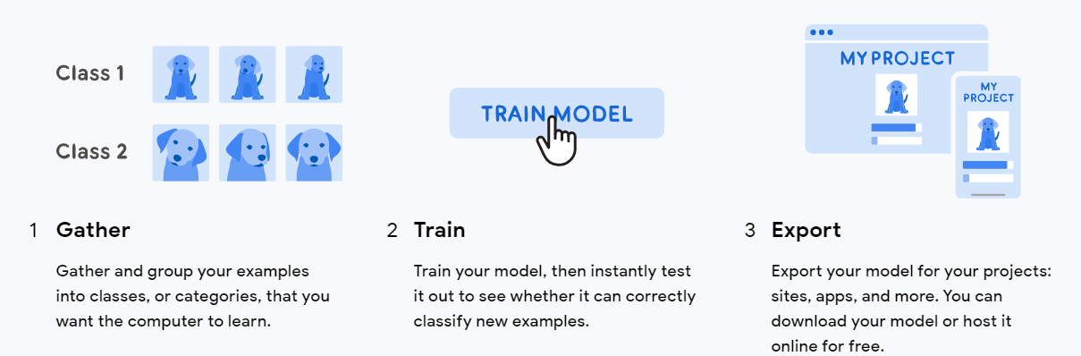
How do I use it?

Slide 4
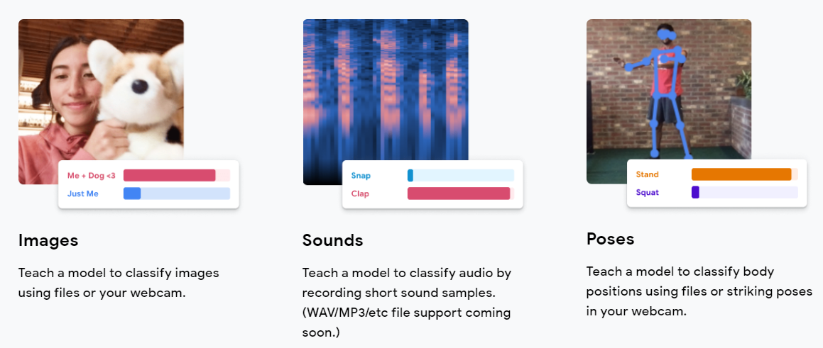
What can I use to teach it?

Slide 5
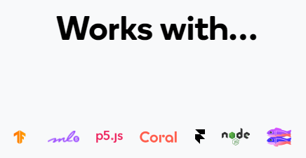
TensorFlow.js
The models you make with Teachable Machine are real TensorFlow.js models that work anywhere javascript runs, so they play nice with tools like Glitch, P5.js, Node.js & more

Slide 6
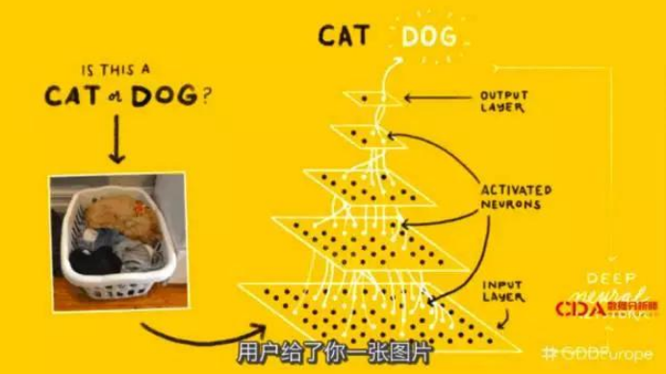
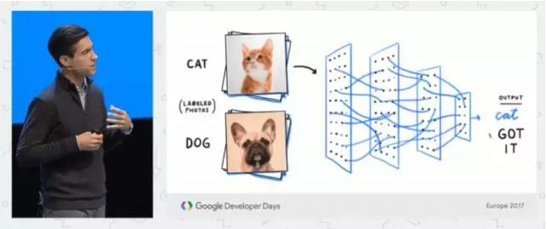
What is TensorFlow?
TensorFlow is an open source library for numerical computation and large-scale machine learning.
TensorFlow was developed by the Google Brain team for internal Google use
TensorFlow can train and run deep neural networks

Slide 7
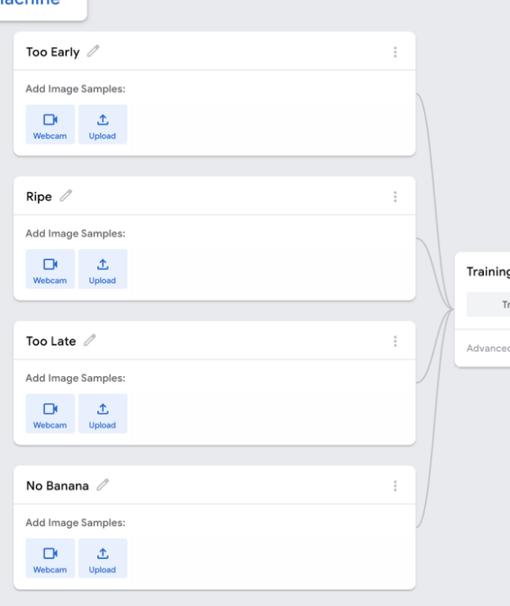
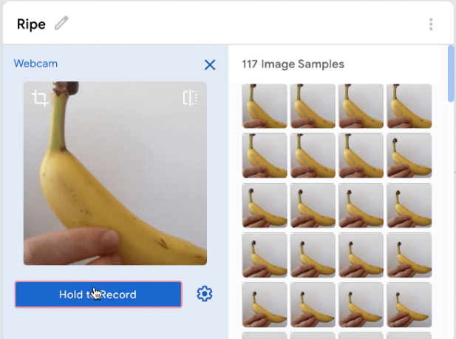
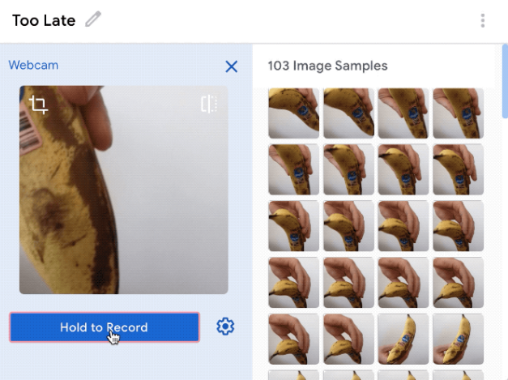
Example (how ripe a banana is?)
Create four classes “Too early”, “Ripe”, “Too Late” and “No banana”
Give each class image samples to learn

Slide 8
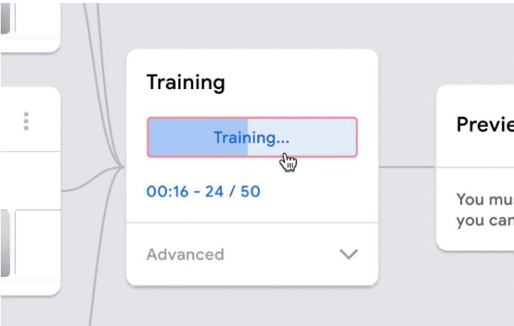
Training
The model is trained locally in your machine (PC), no training data (image) is being uploaded.
Do not switch tab during training!

Slide 9
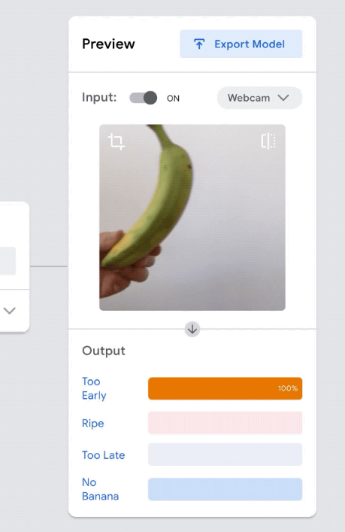
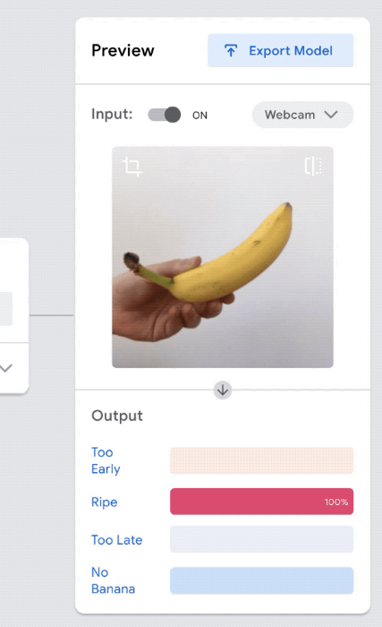
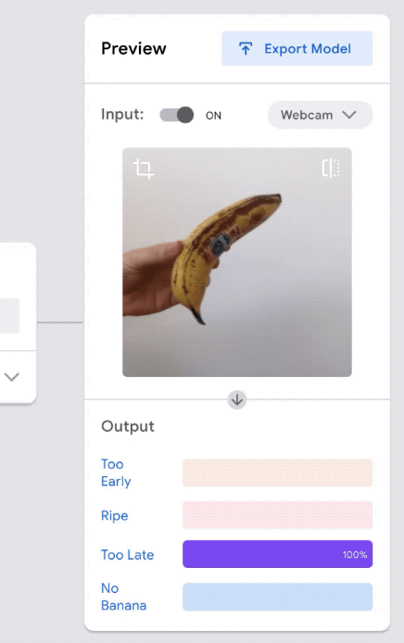
Preview

Slide 10
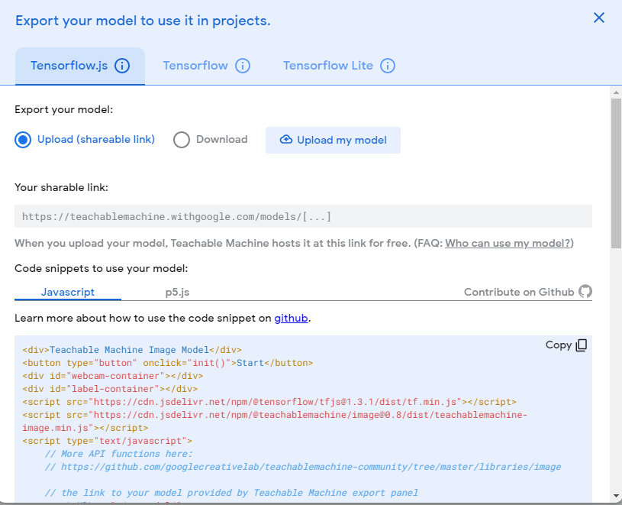
Export Model
You can export your model to use it in projects

Slide 11
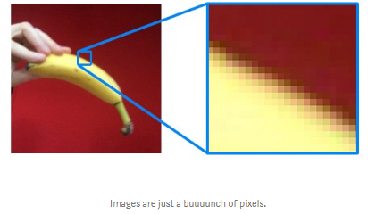
Machine learning has limits!
Images are just numbers & patterns of pixels to a computer
So you haven’t truly taught it what a banana is… we taught it that THIS — a yellow shape against a background, is labelled a ripe banana — it’s just pixels to the computer.

Slide 12
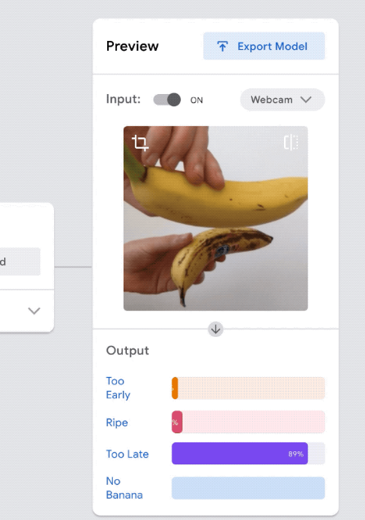
Get confused with two bananas?
the model never saw samples that looked like that while it was training

Slide 13
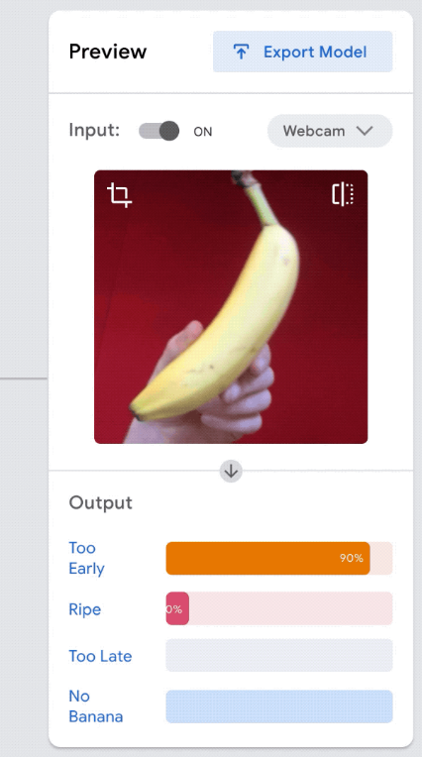
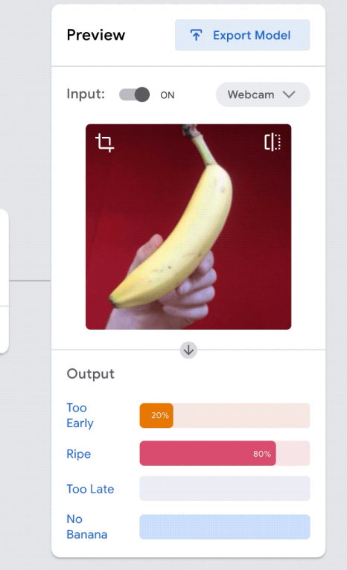
Different Backgrounds & Lighting
Evaluating your bananas on a different background, like a different color wall — does it still work?
On this new background, it gets some of the classes a little confused

Slide 14
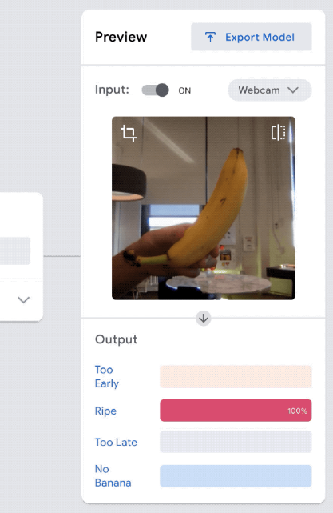
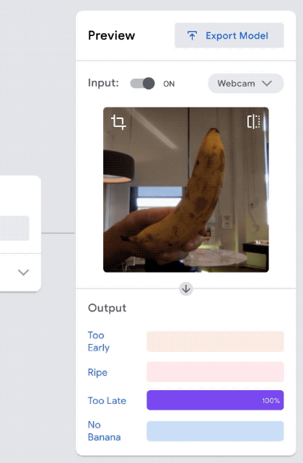
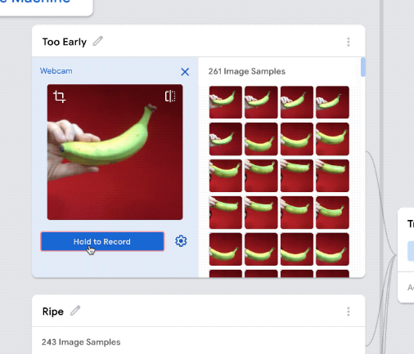
Make the model more robust
Add more images of your bananas in different environments to make your model more robust, so that it can work on different backgrounds.

Slide 15
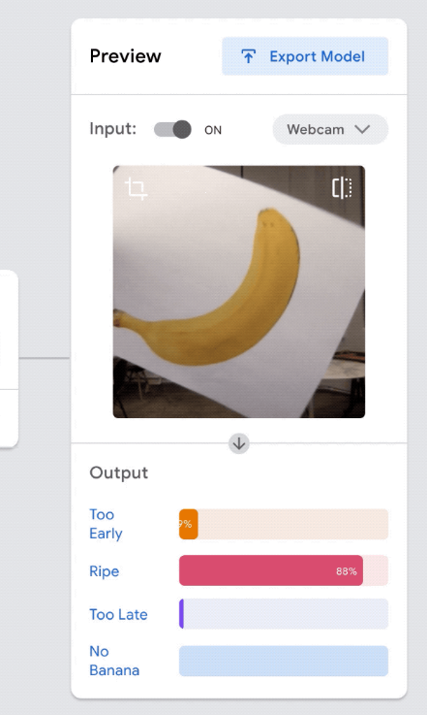
Try to trick it!
Hold up a photo of a banana! Or a drawing of a banana! Or a toy that looks like a banana!

Slide 16
What factors affect the robustness of model
How to increase the robustness of the model
Sample size and varieties
Larger sample sizes and more varieties per each category
Background and Lighting
Clean background image and consistent lighting would be better.
Orientation
Different orientation of object images are included in the samples.

Slide 17
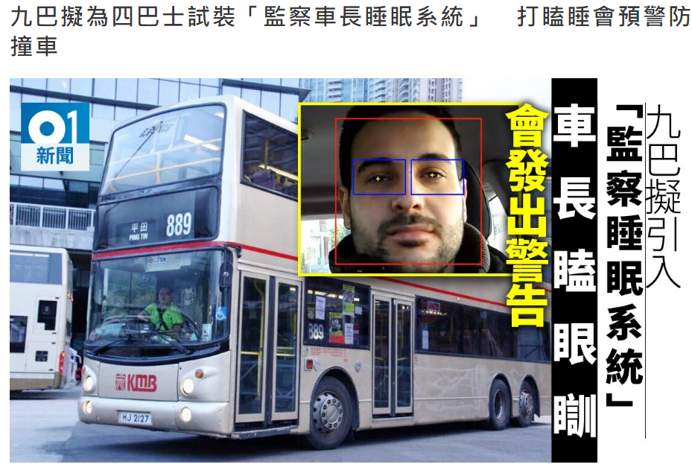
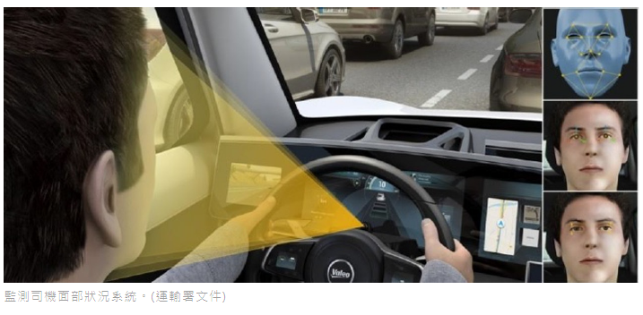
Use Cases of AI in our daily life

Slide 18
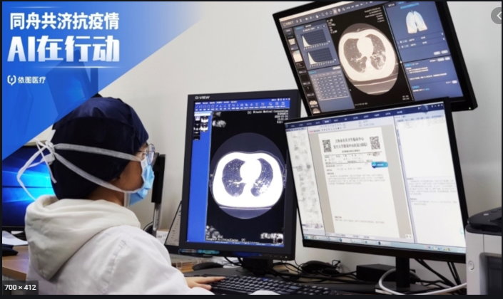
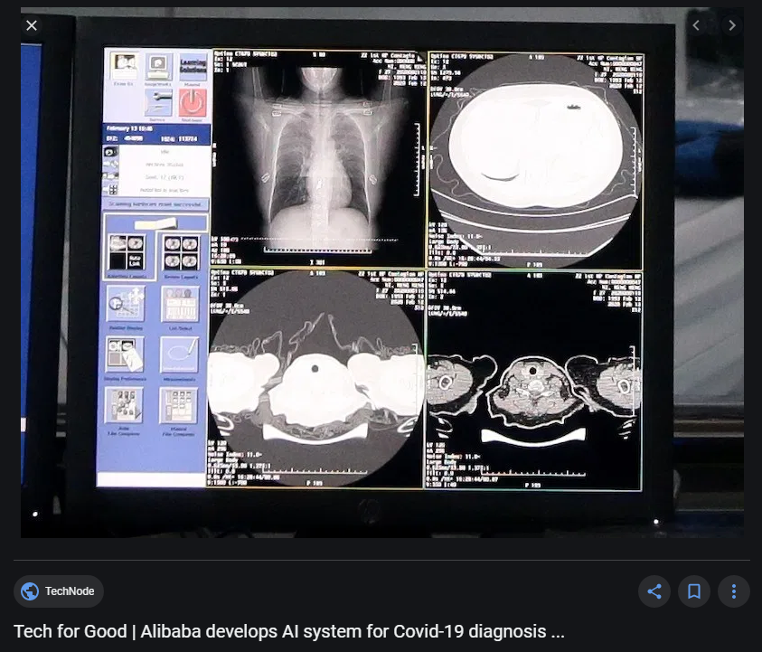
AI system for Covid-19 diagnosis

Slide 19

Continuous Assessment – AI Workshop “Snake Game by using Teachable machine and p5.js”
Notes:
Continuous Assessment (10%)

Slide 20
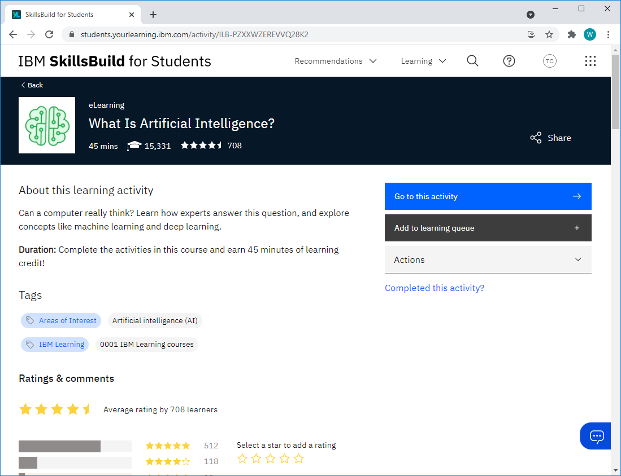
IBM SkillsBuild learning platform (Self-study)
Visit the “IBM SkillsBuild for Students” learning platform (https://skillsbuild.org/)
Sign up and Register a FREE account with your CNA email (Use my Custom ID account)
Select the topic “What is Artificial Intelligence?” and click “Go to this activity” after login.
Notes:
(For student’s self-study)

Slide 21
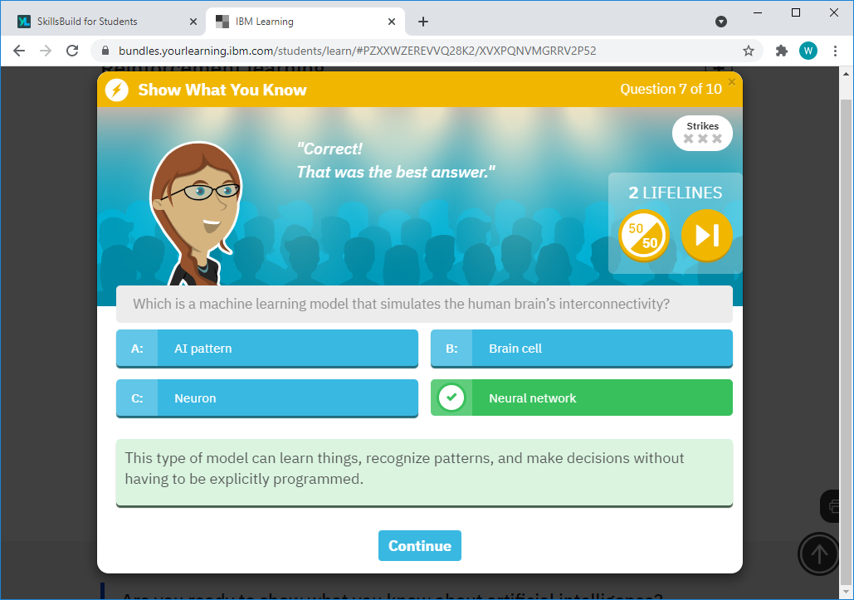
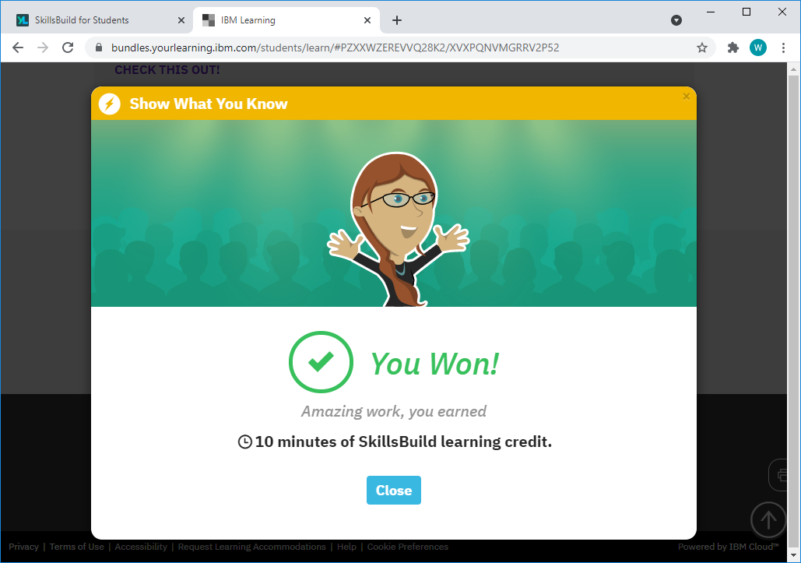
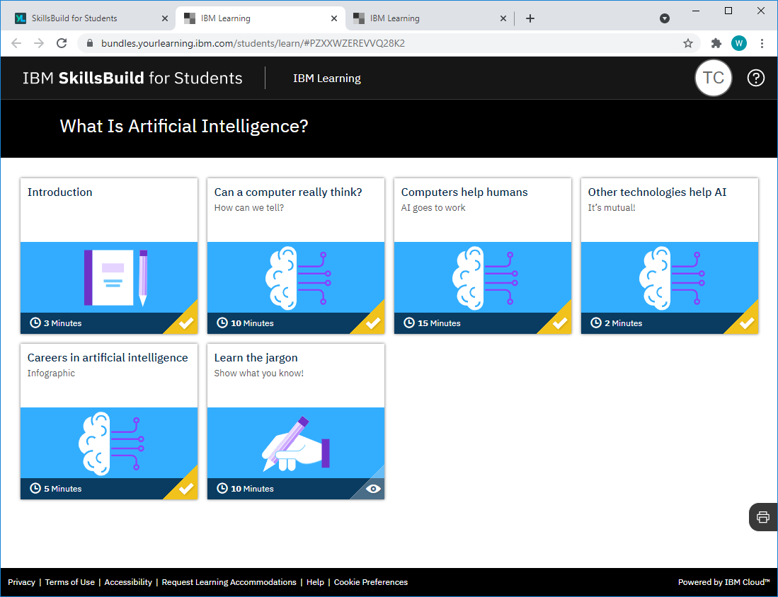
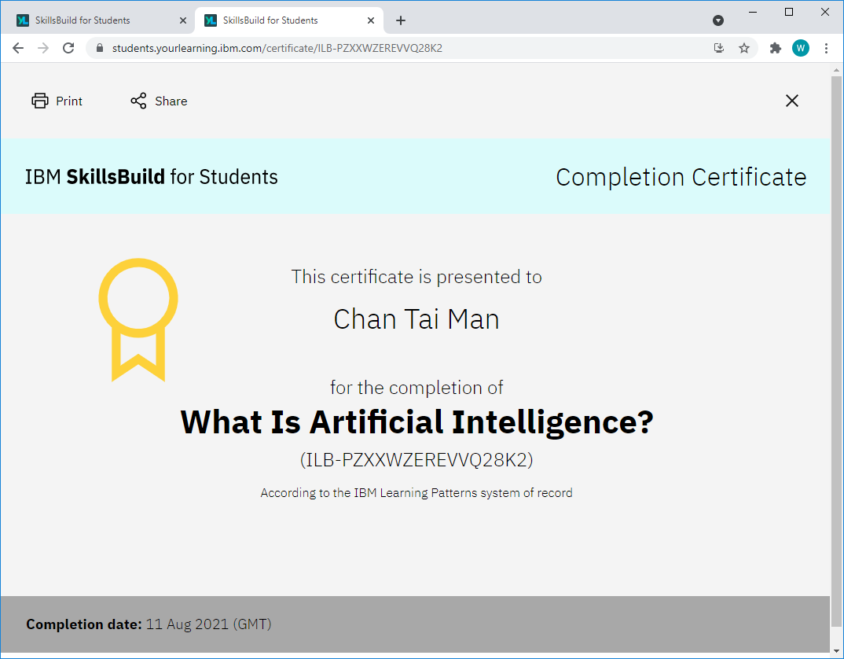
IBM SkillsBuild learning platform (Self-study)
Follow the learning paths and complete the Mini Quiz to earn a Completion Certificate.
Notes:
(For student’s self-study)

